Slide 1
Mutation Testing Tool

Slide 2
What is Mutation Testing
Mutation Testing is a type of software testing in which certain statements of the source code are changed/mutated to check if the test cases are able to find errors in source code. The goal of Mutation Testing is ensuring the quality of test cases in terms of robustness that it should fail the mutated source code.

Slide 3
Mutation testing tools
Mutate++ : This tool is stuck during running of mutants in BBN setup
Mull : Unable to install in container
→ [Marko] can you check with docker expert
Dextool : No package in docker container

Slide 4
Motivation
Most of the mutation testing tools found online are
not runnable in our build environment
mutants created from the tools are inefficient.

Slide 5
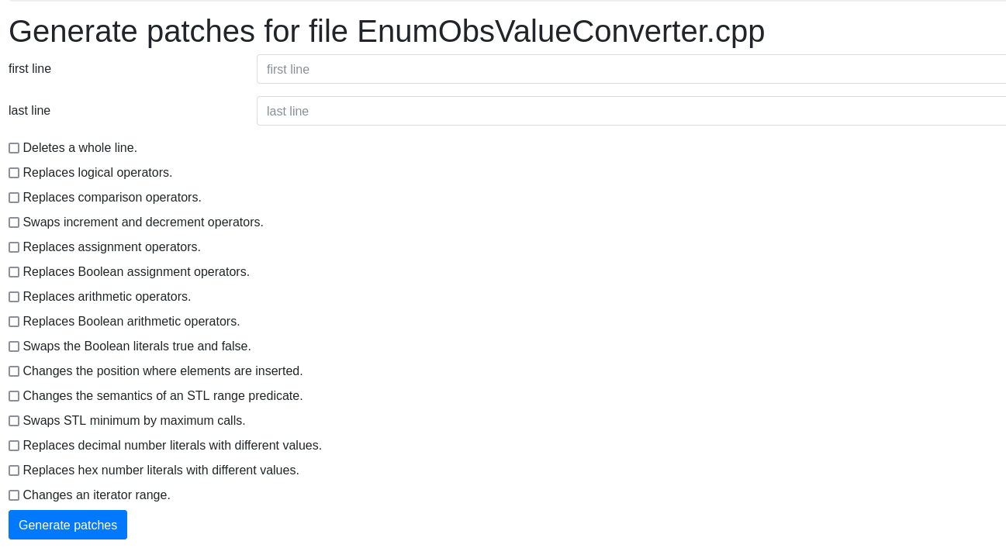
Example

Slide 6
Our mutant
Replace PCD01 with PCD04
Exchange segments/fields in HL7 message

Slide 7
Architecture
ConfigurationMgr
ReadConfig()
Mutate Factory
PerformMutationTesting()
MutateOperator()
FileOperation(MutateOp)
Execute()
Report()
ReplaceOriginalFile()
Execute
Build()
Run()
Mutate(Line)=0
MutateOperator
Report
PrintReport()
FileRead(replaceint obj)
FileWrite()
File Operation
ReplaceInsert
Mutate()
ReplaceInt
Mutate(line )

Slide 8
DEMO

Slide 9
Review from Marko
Clang-tidy : use to make the structure/tree based code.
Mull : can you check with docker expert, how to get this running . Also get to know the concept
Add it as part of Open source

Slide 10
Pending
Formatted report
Error handling

Slide 11
Thank You !

